Slide 1




ITC HOTELS
ITC HOTELS ANALYTICS PROJECT
Presented By KAILASH BISHT

Slide 2

Introduction
THIS PROJECT FOCUSES ON ITC HOTELS, ONE OF INDIA’S TOP LUXURY HOTEL CHAINS. USING REAL-WORLD DATA, WE ANALYZED IMPORTANT FACTORS LIKE ROOM REVENUE, OCCUPANCY RATES, BOOKING PATTERNS, AND CANCELLATIONS. OUR GOAL WAS TO FIND WAYS TO IMPROVE REVENUE, INCREASE OCCUPANCY, AND ENHANCE THE GUEST EXPERIENCE USING DATA ANALYSIS.
WE CREATED VISUAL DASHBOARDS AND USED PREDICTIVE MODELS TO GAIN USEFUL INSIGHTS. THESE INSIGHTS HELP IN MAKING BETTER DECISIONS IN AREAS LIKE OPERATIONS, MARKETING, AND REVENUE MANAGEMENT.
OVERALL, THIS PROJECT SHOWS HOW DATA AND BUSINESS INTELLIGENCE CAN SUPPORT THE GROWTH AND SUCCESS OF LUXURY HOTELS LIKE ITC.

Slide 3
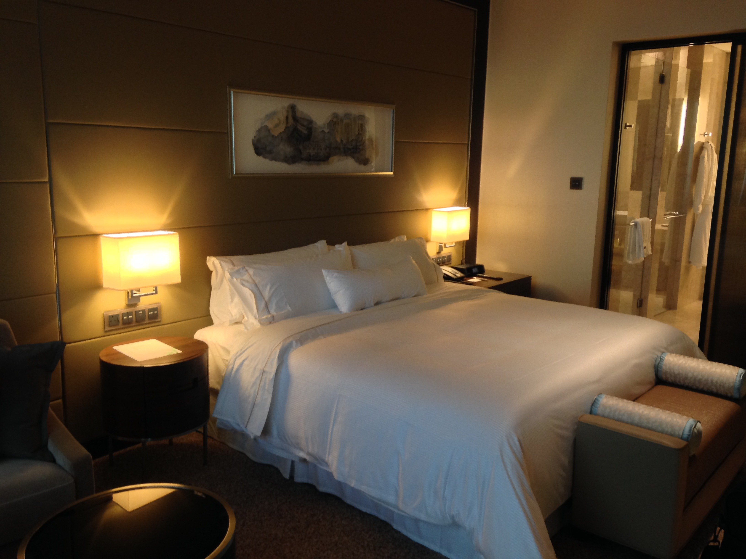
PROBLEM STATEMENT
ITC Hotels operates across multiple luxury properties with diverse room categories, guest profiles, and
seasonal demands. However, like many hospitality businesses, it faces challenges in maximizing revenue,
managing occupancy fluctuations, and reducing booking cancellations—all while ensuring a high-quality
guest experience.
Despite access to large volumes of operational and booking data, there is a gap in translating raw data into
strategic insights that can drive performance improvements. Key questions remain around:
What factors are driving revenue growth or decline across properties?
How do booking patterns and lead time impact occupancy and RevPAR?
What is the revenue loss due to cancellations, and how can it be minimized?
How can ITC Hotels leverage data to make informed decisions in pricing, marketing, and resource
planning?
The project aims to address these questions by applying data analytics, visualization, and performance
modeling, providing a comprehensive view to optimize business outcomes for ITC Hotels.
Problem Statement

Slide 4
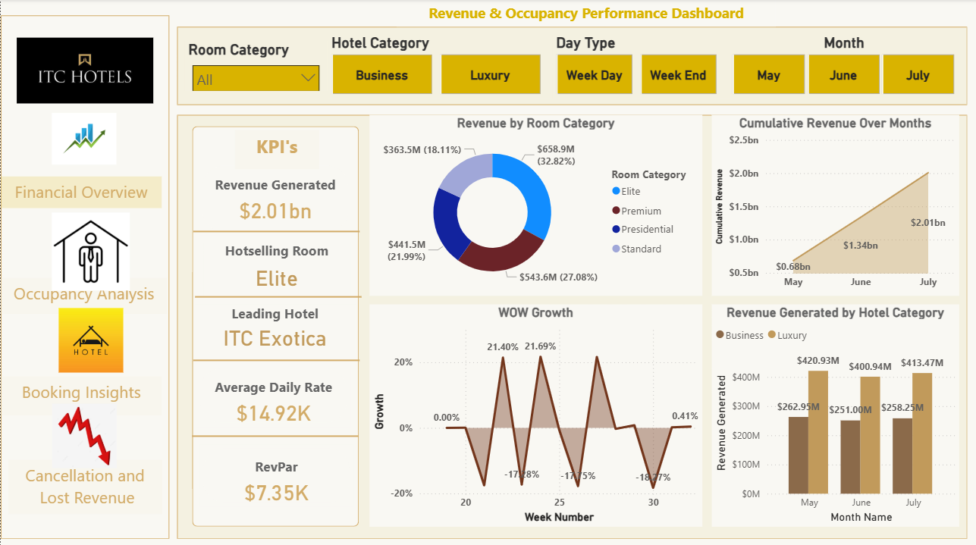
05
/10

Slide 5
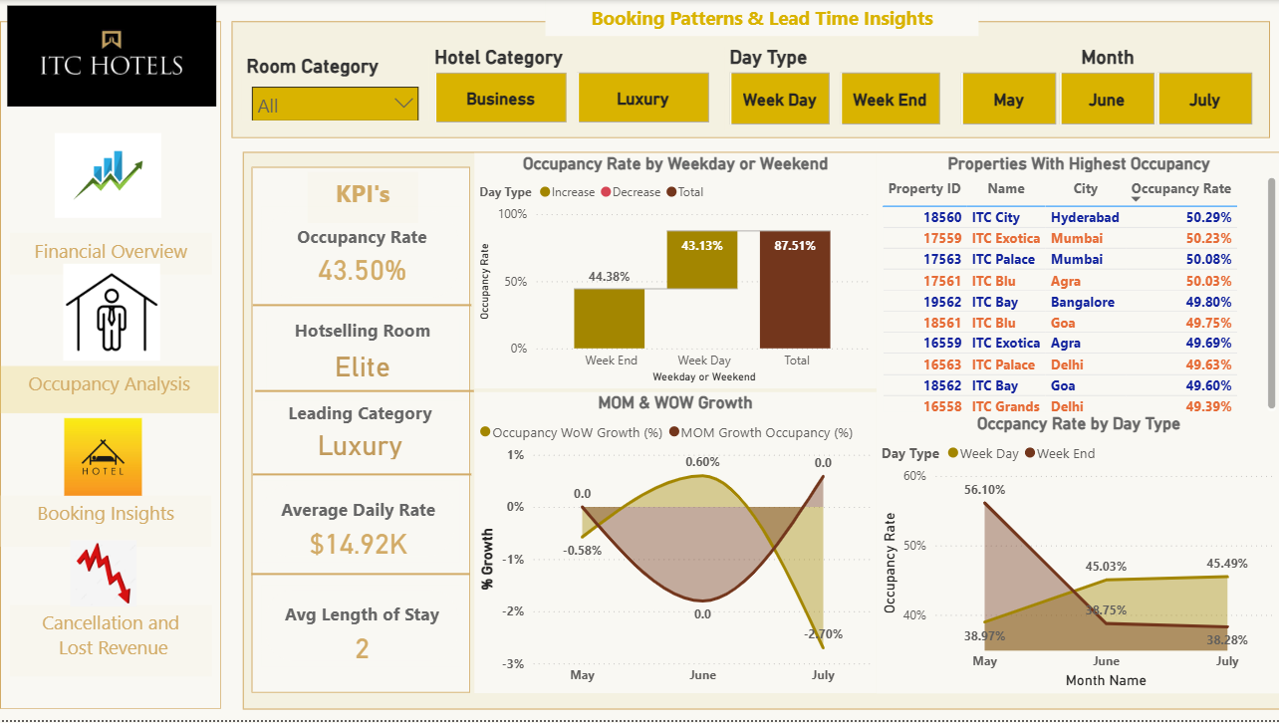

Slide 6
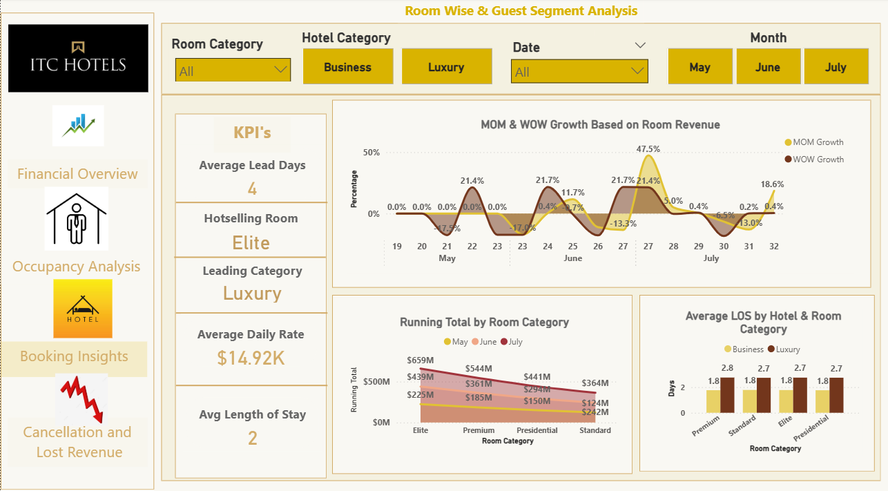

Slide 7
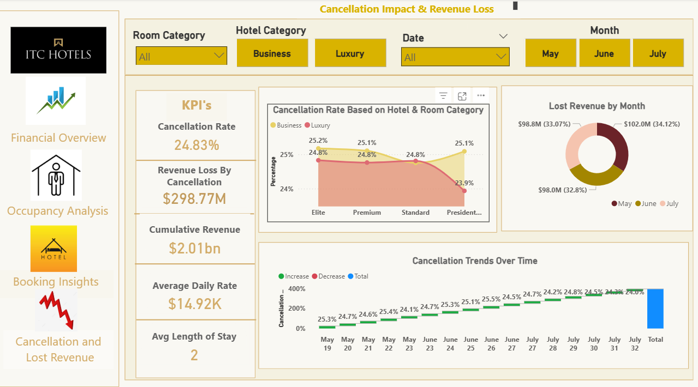

Slide 8
KEY INSIGHTS – FINANCIAL OVERVIEW & REVENUE PERFORMANCE
Total RevenuE: ₹2.01 BILLION (MAY–JULY), WITH A STRONG GROWTH OF 186% FROM ₹700 MILLION TO ₹2.0 BILLION.
ADR (AVERAGE DAILY RATE): ₹14,920, SHOWING A STRONG PREMIUM PRICING STRATEGY.
TOP ROOM CATEGORY: ELITE ROOMS EARNED THE MOST, BRINGING IN ₹658.9 MILLION (32.82% OF TOTAL REVENUE).
TOP PROPERTIES: ITC EXOTICA AND ITC PALACE WERE THE HIGHEST REVENUE-GENERATING HOTELS.
HOTEL TYPE PERFORMANCE: LUXURY HOTELS EARNED MORE THAN BUSINESS HOTELS.
PEAK WEEKLY GROWTH: HIGHEST WEEKLY GROWTH WAS 21.69% IN WEEK 22.
CONCLUSION
ITC HOTELS SAW STRONG REVENUE GROWTH, MAINLY DRIVEN BY ELITE ROOMS AND LUXURY PROPERTIES. HIGH ADR AND REVPAR SHOW THAT THEIR PRICING STRATEGY IS WORKING WELL. THE OVERALL POSITIVE TREND SUGGESTS THERE IS GOOD POTENTIAL TO GROW FURTHER BY FOCUSING ON THE BEST-PERFORMING ROOMS AND HOTELS.

Slide 9
OCCUPANCY AND CAPACITY ANALYSIS
AVERage Occupancy RatE: 43.5% ACROSS ALL ITC HOTELS.
WEEKENDS VS WEEKDAYS: SLIGHTLY HIGHER ON WEEKENDS (44.38%) COMPARED TO WEEKDAYS (43.13%).
TOP PROPERTIES: ITC CITY (HYDERABAD), ITC EXOTICA (MUMBAI), AND ITC PALACE (MUMBAI) HAD OVER 50% OCCUPANCY.
BEST PERFORMING CATEGORY: LUXURY HOTELS HAD THE HIGHEST OCCUPANCY, MATCHING THE PREMIUM PRICING STRATEGY (ADR ₹14,920).
AVERAGE LENGTH OF STAY: 2 DAYS, SHOWING THAT MOST GUESTS BOOKED SHORT STAYS.
CONCLUSION
OCCUPANCY WAS SLIGHTLY BETTER ON WEEKENDS, WITH A STRONG RECOVERY IN JULY AFTER A DIP IN JUNE. METRO CITY HOTELS CONSISTENTLY PERFORMED WELL WITH OVER 50% OCCUPANCY. THE 2-DAY AVERAGE STAY SHOWS A SHORT-STAY TREND, AND THE LUXURY SEGMENT LED IN OCCUPANCY, SUPPORTED BY HIGH ROOM RATES.

Slide 10
ROOM CATEGORY PERFORMANCE & BOOKING INSIGHTS
AveRAGE BOOKING LEAD TIME: 4 DAYS, SHOWING MOST BOOKINGS WERE MADE ON SHORT NOTICE.
TOP REVENUE GENERATOR: ELITE ROOMS EARNED THE MOST, WITH ₹659 MILLION FROM MAY TO JULY.
LENGTH OF STAY (LOS):
OVERALL AVERAGE STAY: 2 DAYS
BUSINESS GUESTS: 2 DAYS
LUXURY GUESTS: UP TO 3 DAYS, ESPECIALLY IN PREMIUM ROOMS
REVENUE GROWTH:
HIGHEST WEEKLY GROWTH: 47.5% IN LATE JUNE
MONTHLY GROWTH SHOWED UPS AND DOWNS, INDICATING UNEVEN BOOKING PATTERNS.
CONCLUSION
ELITE ROOMS MADE THE HIGHEST REVENUE, AND LUXURY HOTELS HAD LONGER GUEST STAYS. MOST GUESTS BOOKED JUST A FEW DAYS IN ADVANCE AND STAYED FOR 2 DAYS. REVENUE GROWTH PEAKED IN LATE JUNE BUT WAS NOT STEADY, SHOWING IRREGULAR BOOKING TRENDS.

Slide 11
CANCELLATIONS & LOST REVENUE ANALYSIS
OVERALL CANCELLATIon Rate: 24.83%, causing a revenuE LOSS OF ₹298.77 MILLION.
MONTHLY LOSS BREAKDOWN:
MAY: ₹98.8 MILLION
JUNE: ₹98.0 MILLION
JULY: ₹102.0 MILLION
BY HOTEL TYPE:
LUXURY HOTELS (PRESIDENTIAL ROOMS): 25.1% CANCELLATION RATE
BUSINESS HOTELS: 23.9% CANCELLATION RATE
WEEKLY TRENDS: STAYED STEADY BETWEEN 24% AND 25.5%.
PRICING IMPACT: DESPITE A HIGH ADR OF ₹14,920, CANCELLATION RATES DIDN’T IMPROVE MUCH.
CONCLUSION
CANCELLATIONS STAYED HIGH AND STABLE, LEADING TO NEARLY ₹300 MILLION IN REVENUE LOSS ACROSS ALL MONTHS. WEEKLY TRENDS SHOWED LITTLE CHANGE, AND EVEN PREMIUM PRICING DIDN’T REDUCE CANCELLATIONS. THIS HIGHLIGHTS THE NEED FOR BETTER BOOKING POLICIES AND GUEST RETENTION EFFORTS.

Slide 12

BROCELLE HOTEL
THANK YOU

